Slide 1
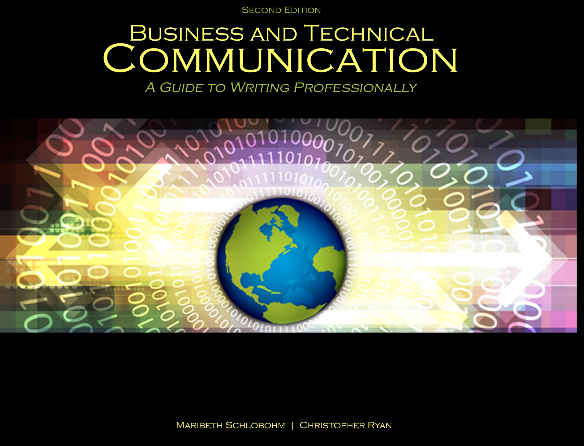
Chapter 4: Working and Writing Collaboratively

Slide 2

Approaches to Collaboration
Management and work styles – must be balanced
Team size – no more than five (in academics)
Establishing team vision - agree on operating rules and principles

Slide 3
Approaches to Collaboration
Scheduling and following timelines
Set team rules
Set deadlines for project components
Determine expectations for accountability
Determine how team will communicate
Gantt charts
Status reports

Slide 4

Maximizing Talents
Roles
Project leader
Project coordinator
Administrative coordinator
Team members

Slide 5

Team Stages of Development (Tuckman)
Forming
Storming
Norming
Performing

Slide 6
Team Writing
Dividing and conquering
Specializing
Concurrent writing

Slide 7

Tools That Assist Process
Face-to-face meetings
Email
Word processing applications
Google Docs
Skype or iChat

Slide 8
Writers vs. Subject Matter Experts
SMEs own:
Content clarity
Safety
Writers/editors own:
Grammar and style
Audience
Voice

Slide 9
References
Schlobohm, Maribeth and Christopher Ryan. Business and Technical Communication: A Guide to Writing Professionally, 2nd Ed., Dubuque, IA: Kendall-Hunt, 2014. Print.
Shutterstock, “Gathered team of four making an important choice,” Image Id: 132769370; “Successful business team with arms up at the office,” Image Id: 127070438; “Smiling businesswoman in the office on video conference,” Feb 2014. Web.
Tuckman, Bruce. “Developmental sequence in small groups,” Psychological Bulletin 1963 (6): 384-99. Print

Slide 10
Contact Information
Kendall-Hunt Publishing Company
4050 Westmark Drive
Dubuque, IA 52004-1840
http://www.kendallhunt.com
Toll Free: 800-228-0810

